Slide 1
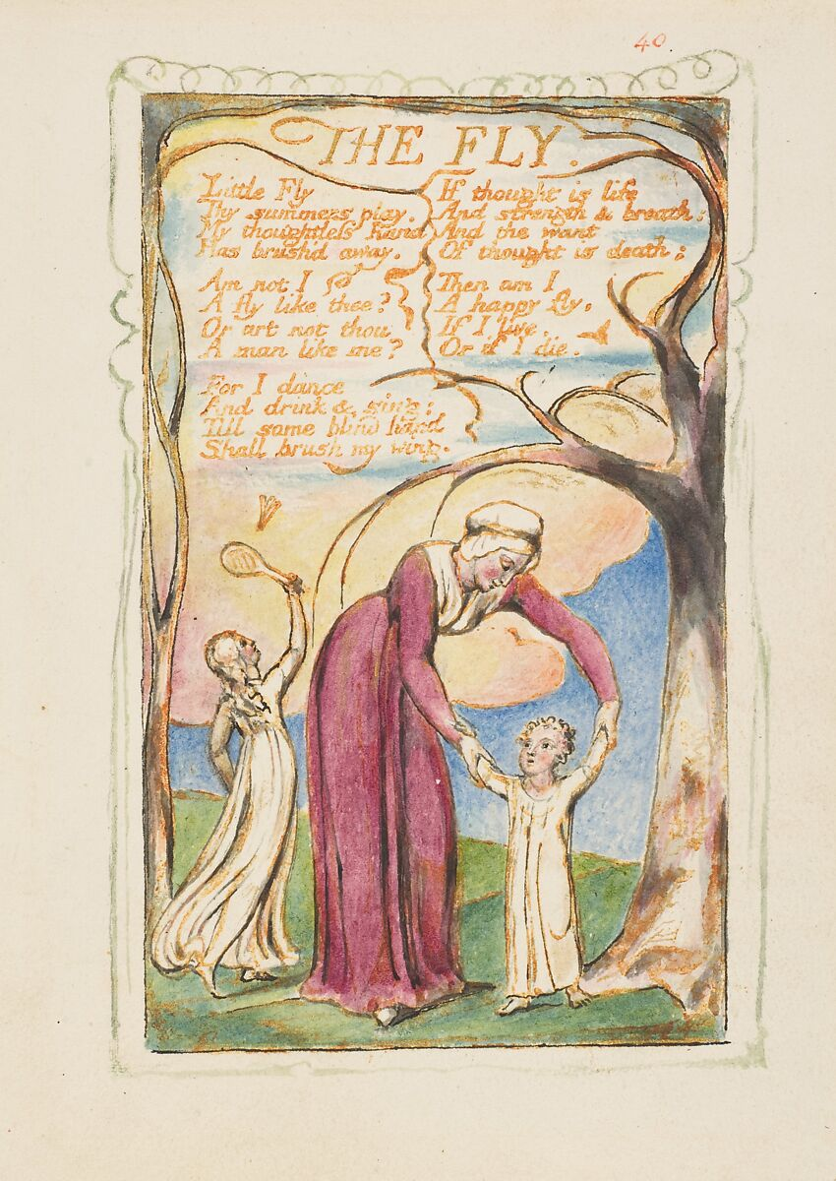
Exploring "The Fly" by William Blake
Presented By:
Sahil Adhikari
Sameer Maharjan
Siddhartha Shakya

Slide 2
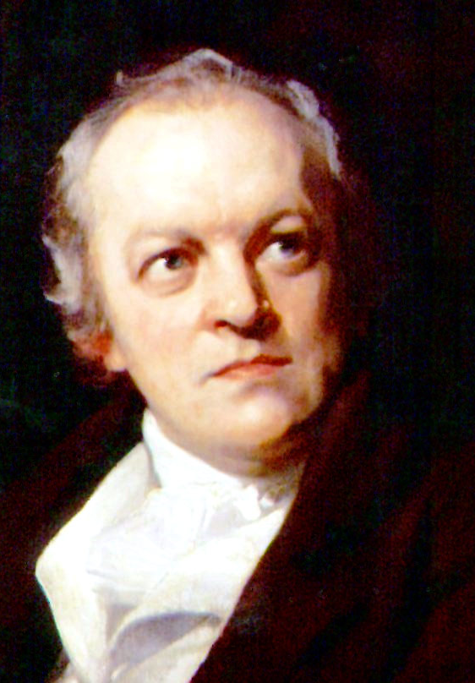
About the Author
William Blake (1757–1827)
English poet, painter, and printmaker
Known for his visionary works and romantic poetry
Influential figure in the Romantic Age of literature
This Photo by Unknown author is licensed under CC BY-SA.

Slide 3
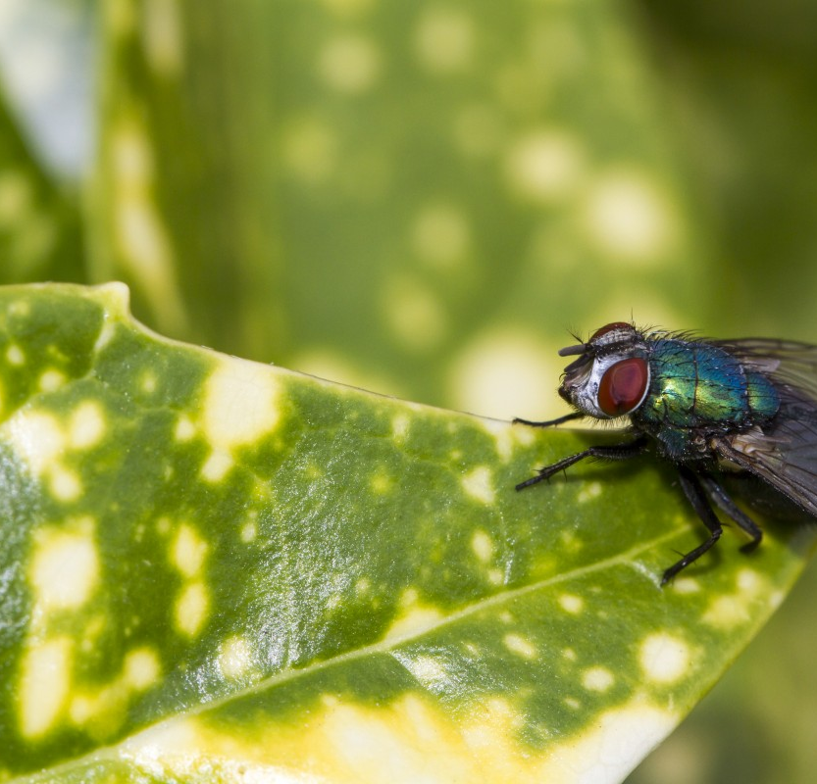
Main Theme
The poem reflects on the transient nature of life and the inevitability of death.
Blake uses the image of a fly to explore profound existential questions.
Themes include mortality, the brevity of human existence, and the insignificance of individual lives in the grand scheme of things.

Slide 4
Analysis of the Poem (1st Stanza)
Little Fly
Thy summer’s play
My thoughtless hand
Has brushed away.
The poet who is sitting outside in summer is thinking about a little fly, whom his thoughtless hand (means without thinking his hand) killed.
The poet is thus not happy with what he has done. However his conscious wakes up after killing the fly.

Slide 5
Analysis of the Poem (2nd Stanza)
Am not I
A fly like thee?
Or art not thou
A man like me?
The poet compares himself to the fly. He asks the fly (in imaginations as it is dead now) a rhetorical question “aren’t both of them similar to each other”.

Slide 6
Analysis of the Poem (3rd Stanza)
For I dance
And drink and sing,
Till some blind hand
Shall brush my wing.
According to the poet, they are similar in the way that he also dances, drinks and sings like the fly until one day when someone (here means God) will “brush his wing” i.e. take away his life as he did to fly.

Slide 7
Analysis of the Poem (4th Stanza)
If thought is life
And strength and breath,
And the want
Of thought is death,
Like a fly, the speaker says, he himself will only have "thought" (that is, consciousness) so long as he has "life and strength and breath".
The word "want" here refers to the absence or lack of something. In this context, it suggests the absence of thought or consciousness.
Death is portrayed as the absence of thought or consciousness.

Slide 8
Analysis of the Poem (5th Stanza)
Then am I
A happy fly,
If I live,
Or if I die.
The speaker's declaration of being a "happy fly" reflects a sense of peace and calmness in the face of life's uncertainties and inevitabilities.
It suggests an acceptance of the transient nature of existence and an embrace of the present moment, whether it leads to life or death.

Slide 9
Conclusion
In conclusion, "The Fly" by William Blake prompts reflection on life's brevity and the acceptance of mortality.
Through its verses, it invites readers to find contentment in embracing the present moment, regardless of life's transient nature.

Slide 10
Questions for Discussion
What is the poet's "wing"? What is the "blind hand"?
The poet's "wing" symbolizes their own mortality and vulnerability, just as the fly's wing represents its delicate and transient existence.
The "blind hand" refers to the unseen forces of fate or mortality (God) that ultimately determine whether we live or die.

Slide 11
Questions for Discussion
What is the major comparison in the poem between man and fly?
The major comparison in William Blake's poem "The Fly" between man and fly is the acknowledgement of how both of them dance, sing and live their life until some blind hand will take their life away. Both the fly and the speaker are subject to the same fate, despite their differences in size and significance.

Slide 12
Questions for Discussion
What is the central argument in the poem?
The central argument in William Blake's poem "The Fly" revolves around the acceptance of mortality and the transient nature of life. Through contemplation of the fly's brief existence and its parallels to human life, the speaker confronts the inevitability of death. The poem urges readers to find contentment and meaning in embracing the present moment, despite life's fleetingness. It emphasizes the interconnectedness of all living beings and encourages acceptance of the natural cycle of life and death.

Slide 13
Questions for Discussion
What will the poem mean if the “blind hand” refers to Fate or Destiny? Explain.
In this interpretation, the "blind hand" becomes a metaphor for the impersonal and inevitable forces that govern human life, rather than a literal physical action.
If the "blind hand" represents Fate or Destiny, then the poem suggests that human life, like that of the fly, is ultimately subject to the whims of a greater, unseen power. It implies that our lives are predetermined or guided by forces beyond our control, and that our actions and choices may ultimately be insignificant in the face of these larger cosmic forces.
It underscores the idea that regardless of our efforts or desires, we are all subject to the same fate, and that acceptance of this reality is essential for finding peace and contentment in life.

Slide 14
Thank You
Thank you for exploring "The Fly" by William Blake with us.
We invite you to continue exploring Blake's works and the themes they evoke.
Feel free to reach out with any further questions or discussions.

